Slide 1
Discussion 13th October

Slide 2
Updated pseudo code -
Shared Locks 1. Object producer 2. Object consumer 3. Boolean moreLinesLeftInFile
Shared DS 1. Queue<Edge>
Reader thread (Producer)
boolean readEntriesFromFile(batchSize) {
for(1 -> batchSize) {
element = readFromFile();
if (element != null) {
IOQueue.offer(element)
} else {
synchronized(moreLinesAreLeftInFile){
moreLinesAreLeftInFile = false
}
return false;
}
}
return true;
}
run () {
while (true) { ————-> point of contention
lock.acquire()
boolean hasMore = readEntriesFromFile(batchSize)
synchronized(consumer){
consumer.notifyAll()
}
if(!hasMore) {
lock.release()
return;
}
synchronized(producer){
lock.release()
producer.wait()
}
}
}
Partition Threads (Consumer)
run () {
while (true) {
Edge edge = IOQueue.poll()
if (edge is not null) {
decidePartition()
}
else {
synchronized(moreLinesAreLeftInFile){
if(!moreLinesAreLeftInFile) break;
}
————-> point of contention
lock.acquire()
if(!IOQueue.isEmpty()) { lock.release(); continue; }
synchronized(producer){
producer.notify()
}
synchronized(consumer){
lock.release()
consumer.wait()
}
} }
}

Slide 3
Experimental Setup

Slide 4
Github Social Network
|V| - 37700, |E| - 289003
Batch size is decided by x% of the order of total edges x = 1, 10, 100
eg. number of edges in above network is in order of 100k, hence the batch size taken are 1000, 10000, 100000
Number of threads = 10
All time data is measured in (ms)

Slide 5
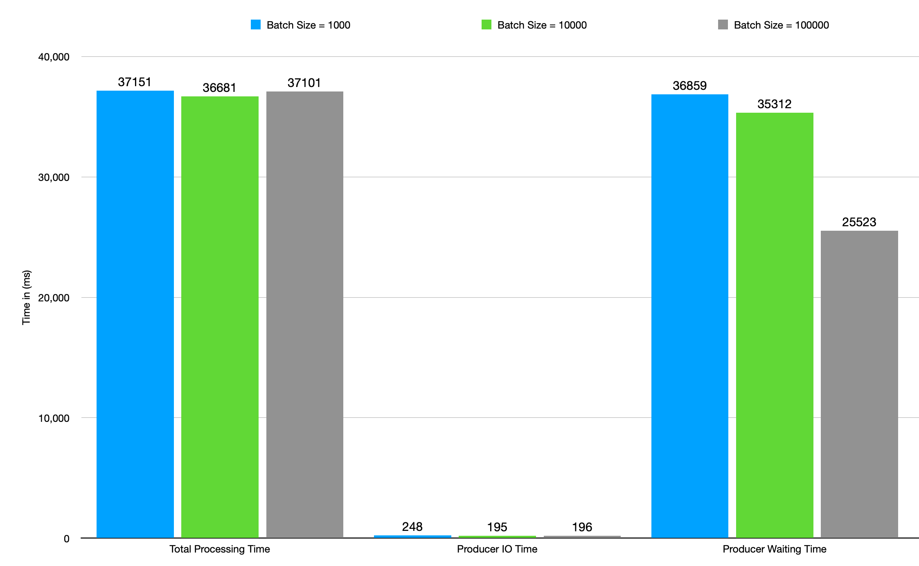
ConcurrentLinkedQueue - (updated metrics)

Slide 6
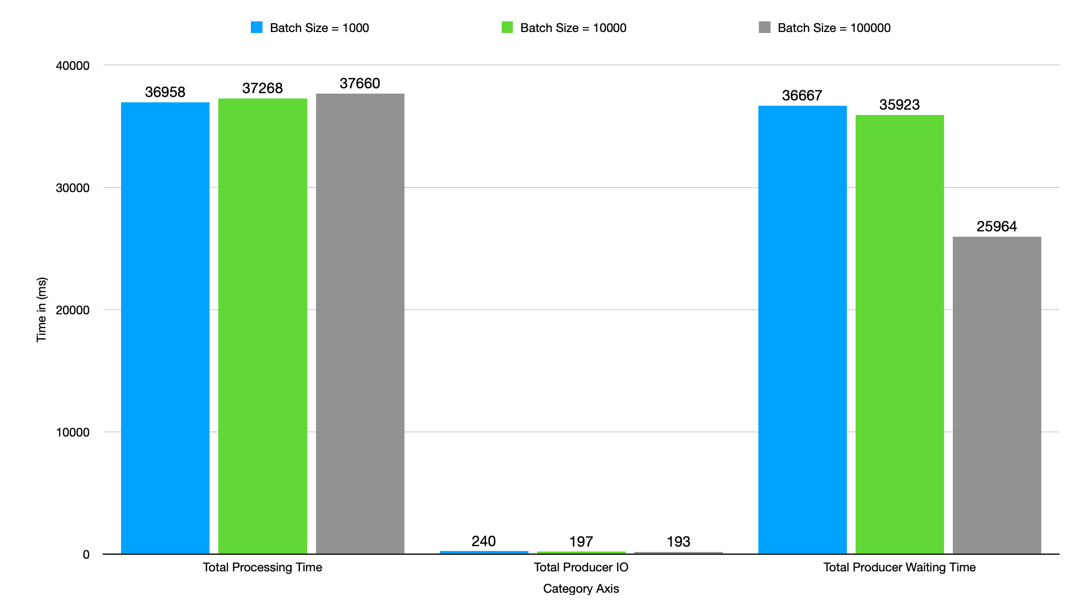
LinkedBlockingQueue - (updated metrics)

Slide 7
Youtube Social Network
|V| -1134890 (~1 million ) , |E| - 2987624 (~ 2 million)
Batch size is decided by x% of the order of total edges x = 1, 10, 100
eg. number of edges in above network is in order of millions, hence the batch size taken are 10000, 100k, 1million
Number of threads = 10
All time data is measured in (ms)

Slide 8
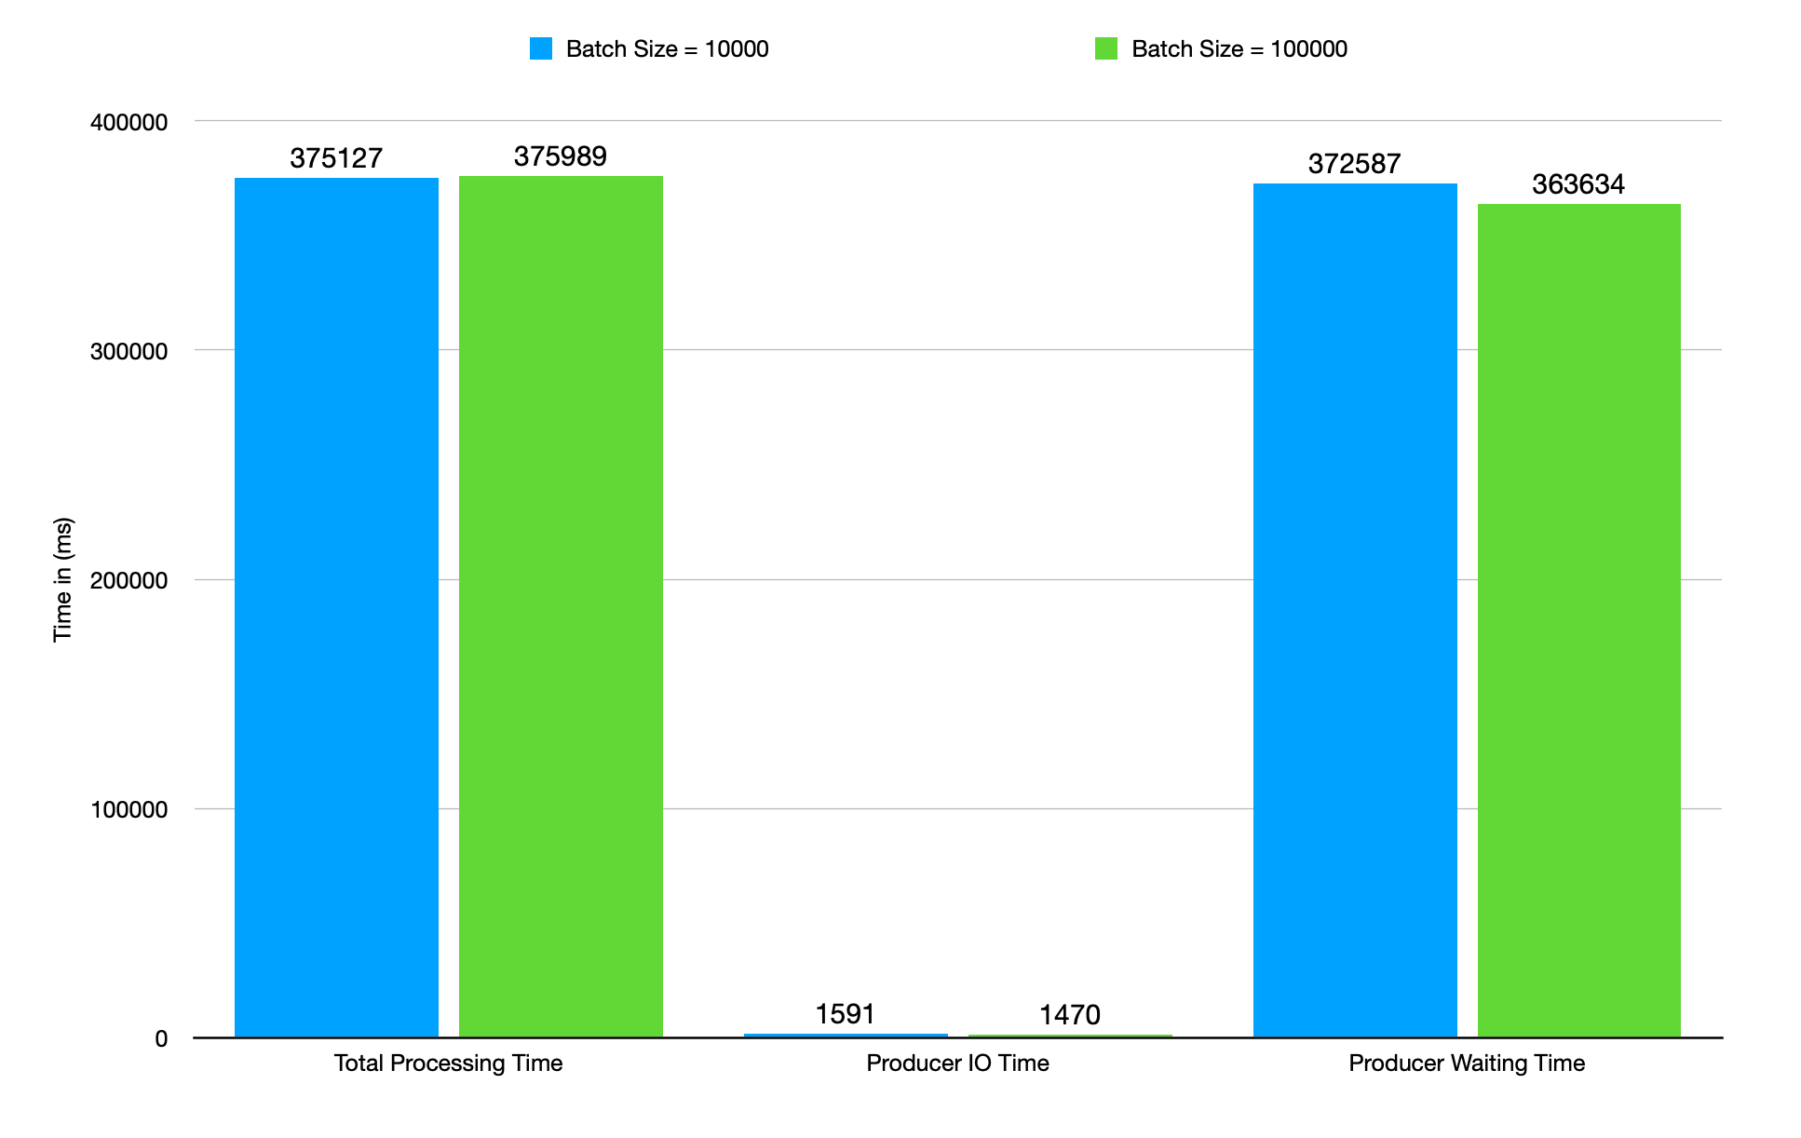
ConcurrentLinkedQueue - (updated metrics)

Slide 9
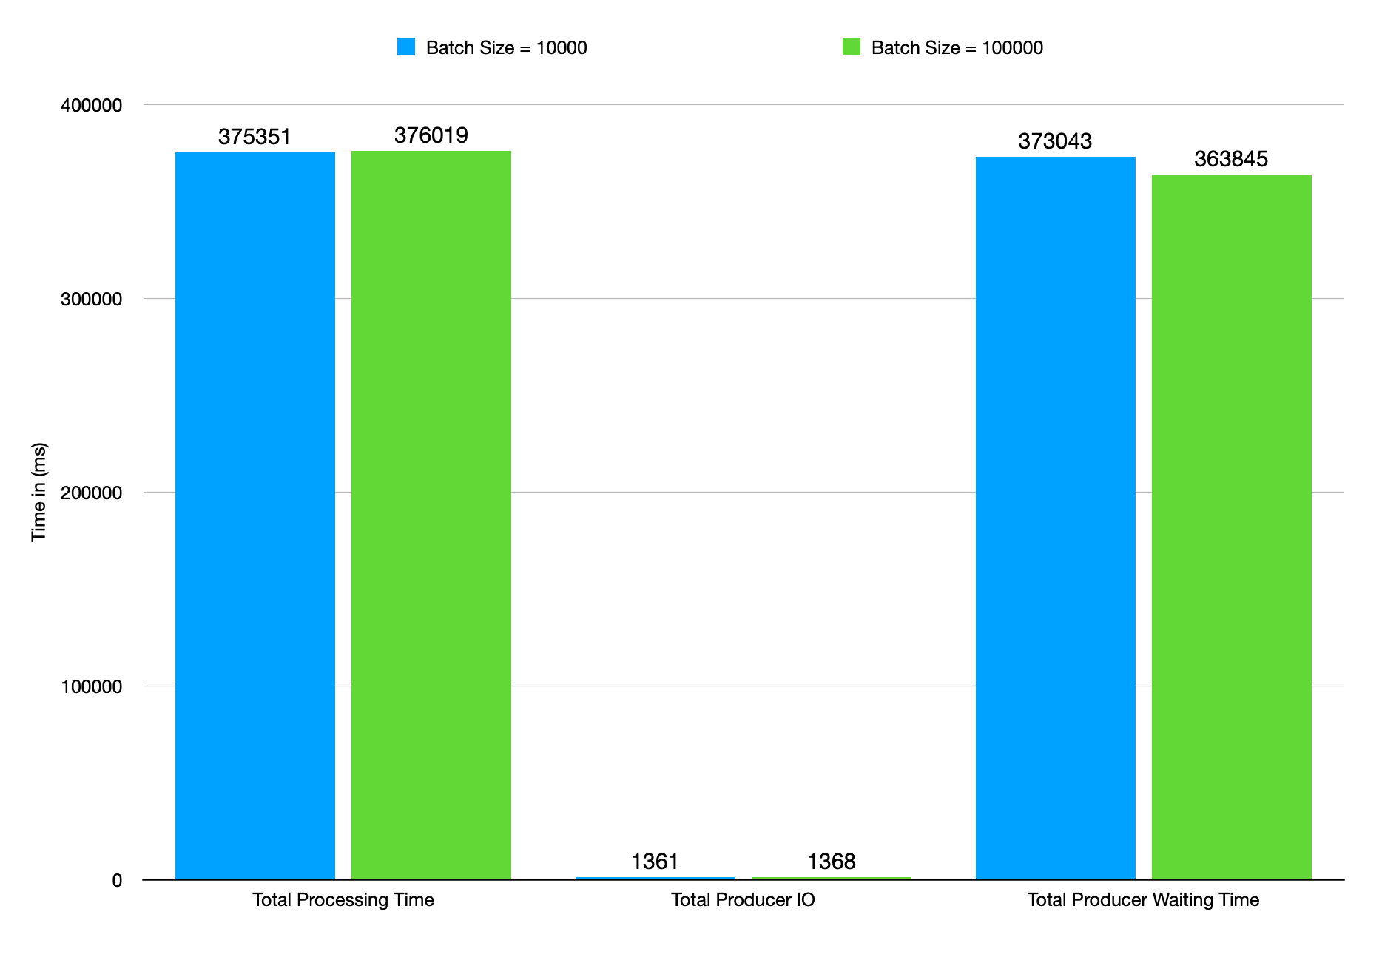
LinkedBlockingQueue - (updated metrics)

Slide 10
Limits on the queue size -
LinkedBlockingQueue
As per docs, since LBQ is optionally bounded, if capacity is not specified the maximum capacity is INTEGER.MAX_VALUE (2^31-1) ~ 2 billion
ConcurrentLinkedQueue
- ?? ( how to get OutOfMemory )

Slide 11
Decision - Hypothesis
Going with ConcurrentLinkedQueue with explicit lock based waiting seems like the correct choice 1. Unboundedness of the queue implies that there is no practical limit on the batch size which is not the case with concurrentLinkedQueue. 2. Even though in relatively smaller batch sizes the processing time difference isn’t stark but for very large graphs it might become evident

